Slide 1

Passwordless Cloud Authentication using Biometric - Derived Keys and Signature of Elliptic Curve
Team Members:-
PENKI JYOTHI (5221411202)
KOSURU KAMAKSHI(5221411192)
YARRA VASU(5221411169)
Y V AVINASH(5221411210)
Project Guide:-
Prof. Bh. PADMA
M.Tech,Phd

Slide 2
Table of Contents
Introduction
Abstract
Literature Survey
Requirements & Analysis
System Design
UML Diagrams
Implementation
Testcases
Results
Conclusion
References

Slide 3

PROBLEM STATEMENT
Cloud platforms require strong authentication, but password-based logins are insecure due to weak, reused, or stolen credentials. This leads to risks like data breaches and identity theft. A password less system is desired can provide high security, faster processing, and low resource usage. The challenge is to build a new authentication protocol that ensures security, efficiency, and user convenience.

Slide 4
ABSTRACT
Cloud authentication traditionally relies on password-based mechanisms, which suffer from vulnerabilities such as credential theft, phishing, and weak password practices. To address these challenges, this project proposes a biometric-driven authentication mechanism based on Elliptic Curve Cryptography (ECC). A fixed-length hash is derived from biometric input, which in turn is transformed into a scalar suitable for ECC operations. This paper proposes a Passwordless authentication scheme leveraging biometric data combined with elliptic curve cryptography (ECC). The biometric sample is processed through a secure hash function to derive a secret scalar, which is then used to generate ECC private and public keys. Authentication is performed via ECDSA signatures without transmitting the biometric data itself, ensuring privacy and strong security guarantees. This method eliminates password-related risks, enhances user experience, and resists phishing, replay, and credential stuffing attacks.

Slide 5
INTRODUCTION
Passwordless cloud authentication using biometric-derived keys (often leveraging Elliptic Curve Cryptography, or ECC) is a modern, high-security approach that eliminates traditional passwords, shared secrets, and the risk of server-side credential theft.
It works by allowing a user to unlock a locally stored, hardware-bound private key using a biological trait (fingerprint, facial recognition), which then signs authentication challenge. This method is phishing-resistant, cryptographically secure, and aligned with FIDO2/Webathon standards.
Biometric Authentication
Biometric authentication stands at the forefront of passwordless technologies, utilizing unique physical or behavioural characteristics to verify a user's identity. This method capitalizes on the inherent traits of individuals, offering a high level of security and convenience.

Slide 6
REQUIREMENTS & ANALYSIS
Software Requirements
Operating System: Windows 10/11.
Programming Languages: Python
Libraries / Frameworks:
ECDSA, cryptography → ECC operations
Hash lib → hashing biometric data
Flask → backend API

Slide 7
Hardware Requirements
Processor: Intel i5
RAM: 8 GB minimum (Server), 4 GB (Client)
Storage: 256 GB SSD or higher
Biometric Device: Fingerprint scanner (Mantra RD MFS110)
Network: Stable internet connection

Slide 8
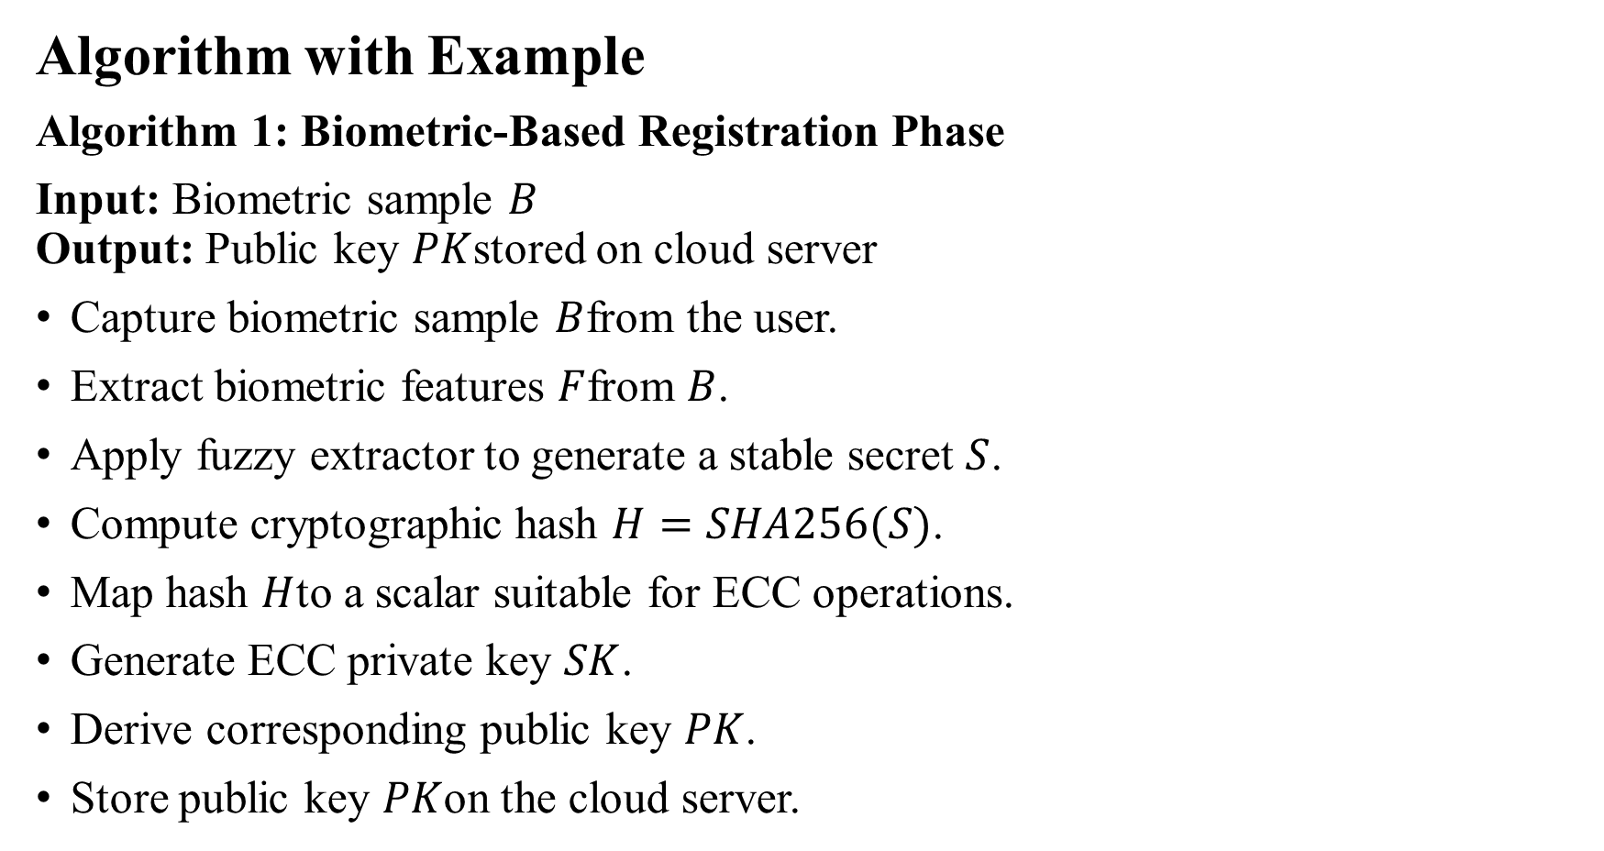
Algorithm with Example
Algorithm 1: Biometric-Based Registration Phase
Input: Biometric sample $B$
Output: Public key $PK$stored on cloud server
Capture biometric sample $B$from the user.
Extract biometric features $F$from $B$.
Apply fuzzy extractor to generate a stable secret $S$.
Compute cryptographic hash $H=SHA256(S)$.
Map hash $H$to a scalar suitable for ECC operations.
Generate ECC private key $SK$.
Derive corresponding public key $PK$.
Store public key $PK$on the cloud server.

Slide 9
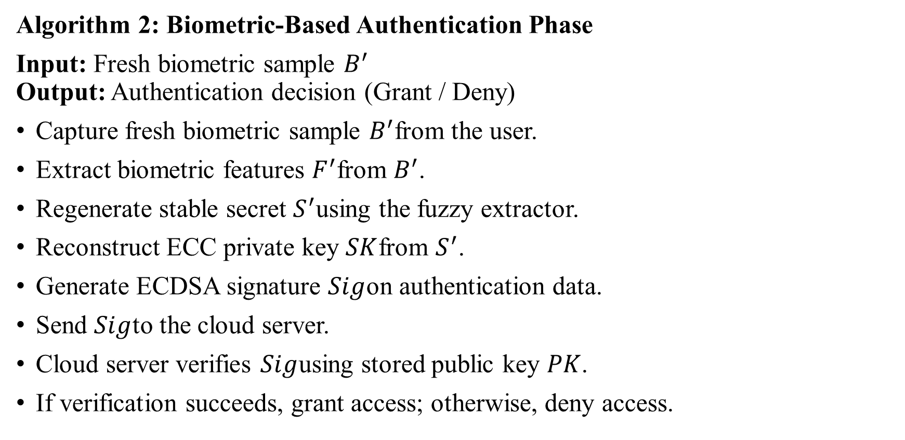
Algorithm 2: Biometric-Based Authentication Phase
Input: Fresh biometric sample $B^{′}$
Output: Authentication decision (Grant / Deny)
Capture fresh biometric sample $B^{′}$from the user.
Extract biometric features $F^{′}$from $B^{′}$.
Regenerate stable secret $S^{′}$using the fuzzy extractor.
Reconstruct ECC private key $SK$from $S^{′}$.
Generate ECDSA signature $Sig$on authentication data.
Send $Sig$to the cloud server.
Cloud server verifies $Sig$using stored public key $PK$.
If verification succeeds, grant access; otherwise, deny access.

Slide 10
LITERATURE SURVEY
1.Secure and Lightweight User Authentication Scheme for Cloud-Assisted IoT IEEE Transactions on Information Forensics and Security, 2023 Cloud-assisted IoT, Authentication, ECC, Forward Secrecy, Lightweight
“This project presents a lightweight multi-factor authentication scheme designed for cloud-assisted IoT systems. Traditional methods often overload gateways and fail against attacks such as replay, insider, and dictionary-based threats. To overcome these issues, the authors propose a protocol that integrates elliptic curve cryptography, fuzzy extractors, honey-words, and public-key cryptography. By shifting heavy computations to the cloud, the system reduces gateway overhead while maintaining strong authentication guarantees. Formal verification using BAN logic and Prover if, along with performance analysis, shows that the scheme achieves high security, supports forward secrecy, and is efficient enough for large-scale IoT environments like smart cities and smart grids.”

Slide 11
2.Privacy Preserving Biometric Authentication and Identification in Cloud Computing International Journal of Advanced Science and Technology (IJAST), Vol. 29, No. 6, 2020 Cloud Computing, Biometric Authentication, Privacy, Cloud Security, Fingerprint Recognition.
“This project focuses on enhancing security in cloud computing through biometric-based authentication and identification mechanisms. It argues that traditional password- and token-based systems are inadequate due to vulnerability to theft, replay, and impersonation. The proposed scheme integrates fingerprint and palm print biometrics to ensure both privacy and accuracy in cloud access. The system performs feature extraction (using Singular Value Decomposition) and generates secure hash codes during registration and verification phases. Additionally, a smartcard-based approach and unique key generation using Diffie-Hellman are incorporated to strengthen data access control. The model ensures that only valid biometric owners can upload, access, and retrieve files securely from the cloud, making it more reliable than conventional authentication methods.”

Slide 12
EXISTING SYSTEM
The current authentication methods for cloud platforms are mainly password-based. Such systems suffer from weak password practices, phishing attacks, credential leaks, and replay attacks, making them unreliable for sensitive applications. Biometric-only systems also exist, but they rely on storing raw biometric data on servers. If the server is compromised, biometric templates can be stolen, and unlike passwords, biometrics cannot be reset or changed, making users permanently vulnerable. Thus, existing systems either lack security or compromise privacy.

Slide 13
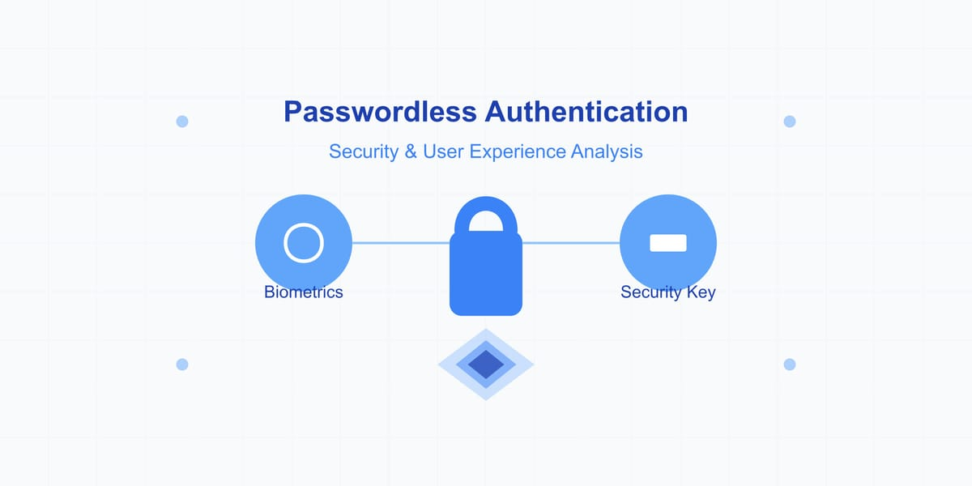
PROPOSED SYSTEM
The proposed system introduces a biometric-driven authentication mechanism integrated with ECC. The biometric input is hashed and transformed into a secure scalar, which is then used to generate ECC keys. During login, the cloud server generates a signature of the user using the private key, and the server verifies it with the stored public key. This ensures privacy and provides robust security against phishing, replay, and brute-force attacks. ECC’s lightweight cryptography also ensures efficient computation and low resource consumption, making it scalable for real-world cloud environments.

Slide 14
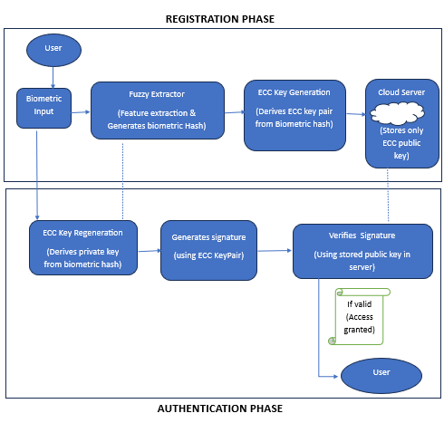
SYSTEM DESIGN

Slide 15
Phase 1: Registration (Identity Enrollment)
​Fuzzy Extraction: Converts raw fingerprints into a stable Biometric Hash and non-sensitive Helper Data.
​ECC Key Binding: Generates an Elliptic Curve key pair.
​Privacy-First Storage: Only the Public Key is sent to the Cloud; raw biometrics are destroyed immediately.
Phase 2: Authentication (Challenge-Response)
​Key Regeneration: Uses new biometric input + Helper Data to reproduce the original Private Key.
​Digital Signature (ECDSA): Proves identity by signing a server challenge locally.
​Cloud Verification: Server validates the signature using the stored Public Key—granting access without ever seeing the secret.

Slide 16
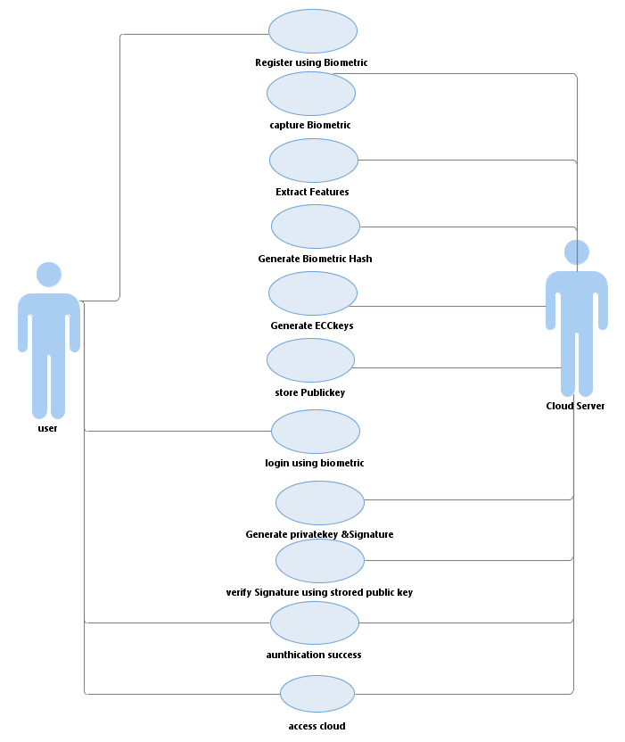
UML DIAGRAMS
Usecase Diagram:

Slide 17
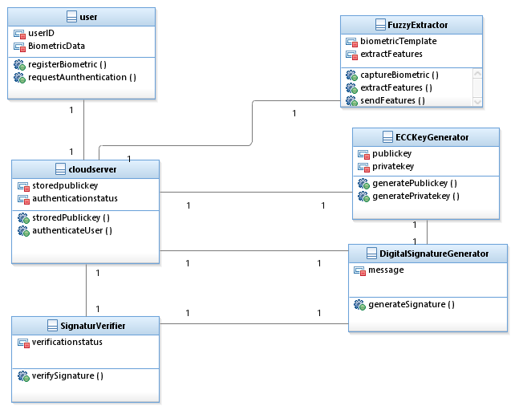
Class Diagram

Slide 18
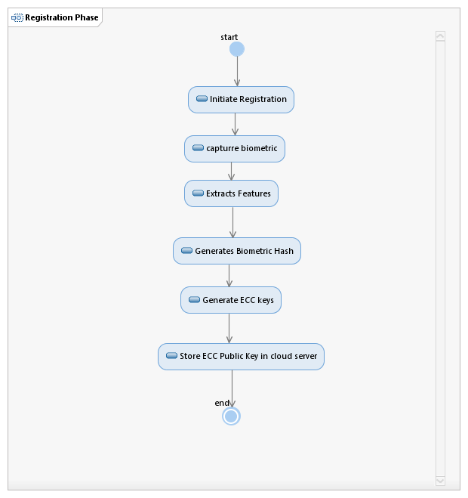
Activity Diagram

Slide 19
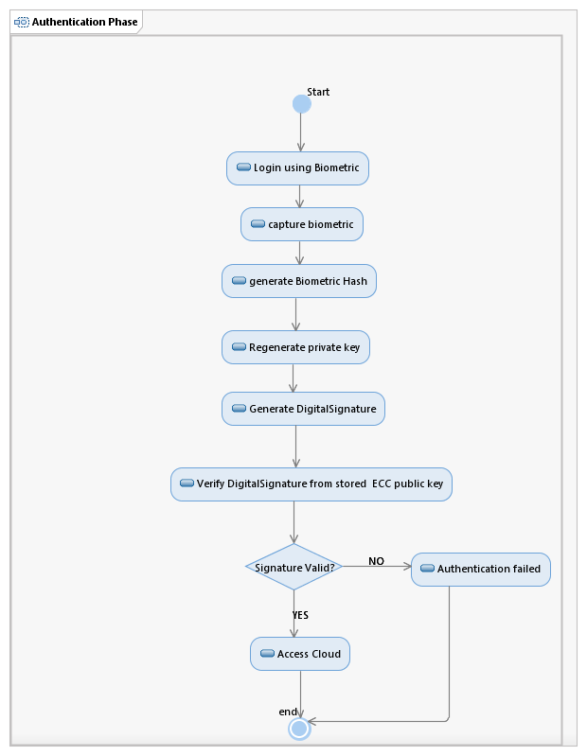

Slide 20
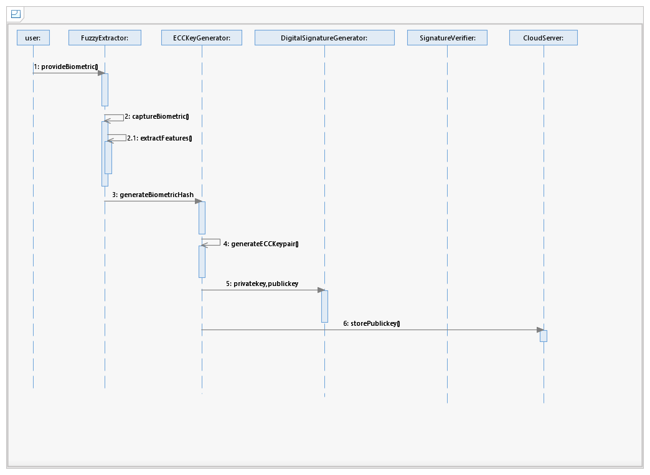
Sequence Diagram
Registration Phase:

Slide 21
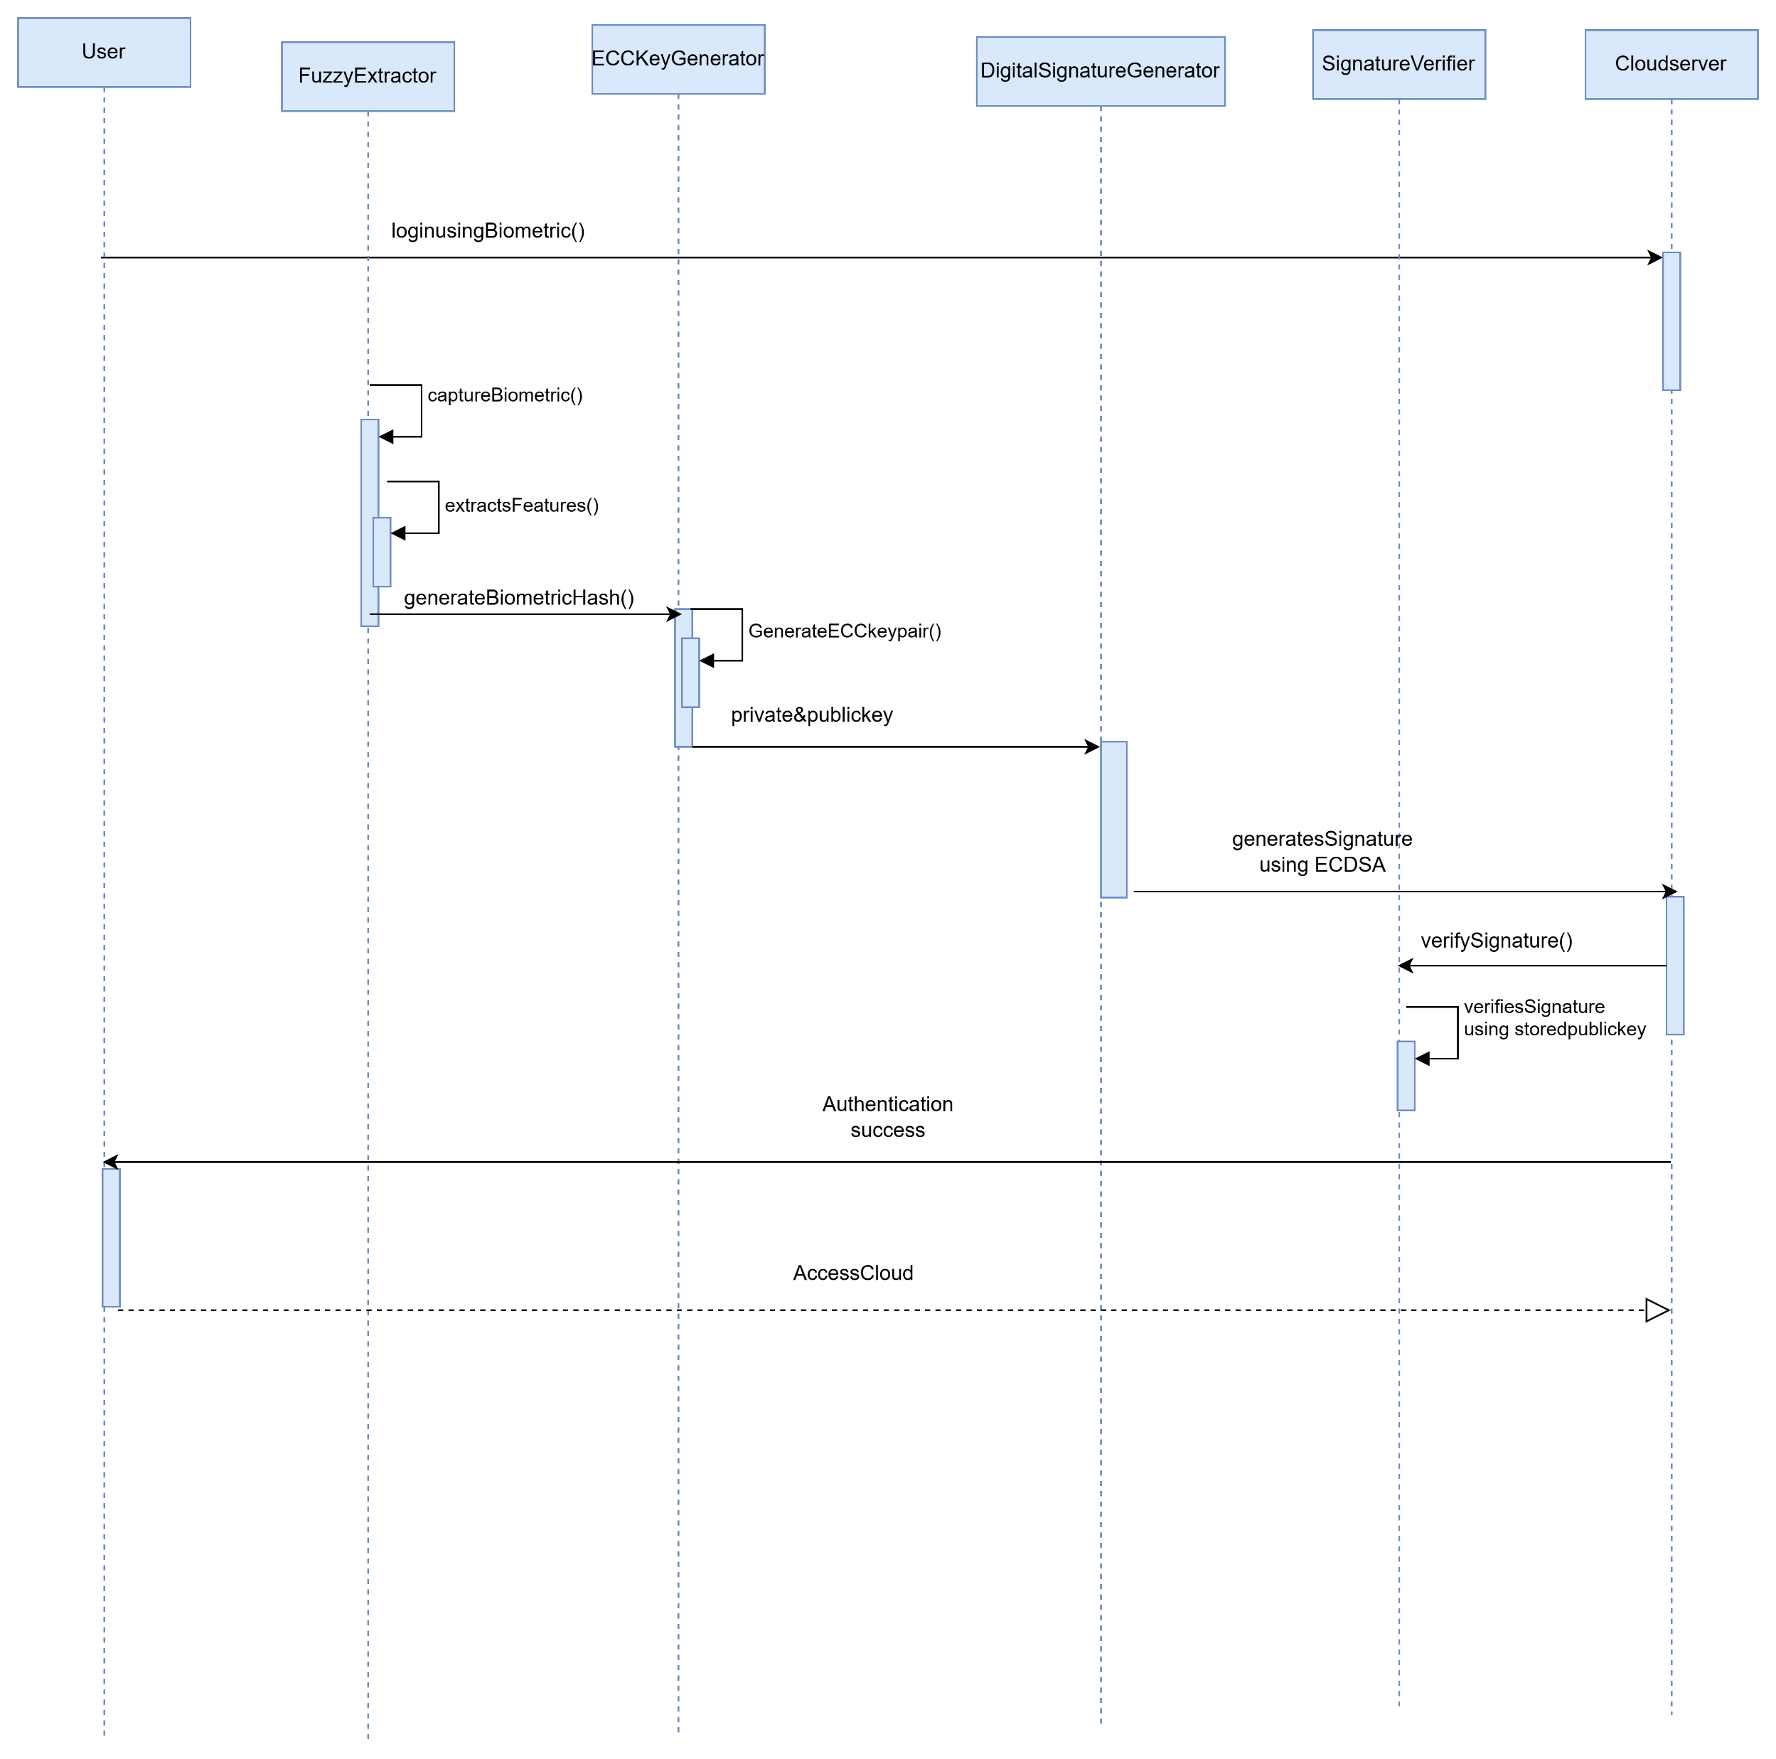
Authentication Phase:

Slide 22
IMPLEMENTATION
The system follows a structured workflow consisting of two main stages: Registration and Authentication.
During the registration phase, the user provides a biometric input such as a fingerprint. This input is processed using a fuzzy extractor to generate a stable biometric template. The template is then hashed using the SHA-256 algorithm to produce a fixed-length secure value. This value is used to generate an ECC key pair, where the public key is stored in the cloud server and the private key is not stored permanently.
During the authentication phase, the cloud server generates a random challenge. The user provides biometric input again, which reconstructs the private key dynamically. This private key is used to sign the challenge using the ECDSA algorithm. The generated signature is sent to the server, which verifies it using the stored public key. If the verification is successful, access is granted.

Slide 23
TEST CASES
Test Case ID | Description | Input | Expected Result
TC-1.1 | Valid User Login | Correct Username + Matching .pub key | UI hides Phase 1, shows User Profile and Phase 2.
TC-1.2 | Invalid Username | Username not in database | Error: "User not found" or "Identity mismatch."
TC-1.3 | Key Mismatch | Valid Username + Wrong Public Key | Error: "Public key does not match record."
TC-1.4 | File Upload | Upload a valid .pub file | Text area should automatically populate with the file content.
Test Case ID | Description | Input | Expected Result
TC-2.1 | RD Service Offline | Scanner disconnected or service stopped | Error: "Scanner Error. Check RD Service."
TC-2.2 | Successful Scan | Valid finger placed on scanner | "Fingerprint Captured " and "Verify" button enables.
TC-2.3 | Biometric Mismatch | Valid User but wrong finger used | Error: "Biometric Data Mismatch" (Private key cannot be reconstructed).
TC-2.4 | Reconstruction | Valid finger + Valid Session | UI transitions to Phase 3 (Digital Signature Proof).

Slide 24
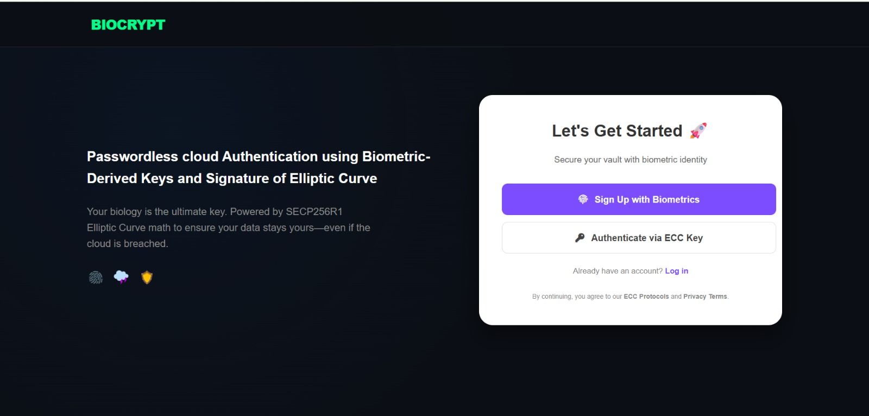
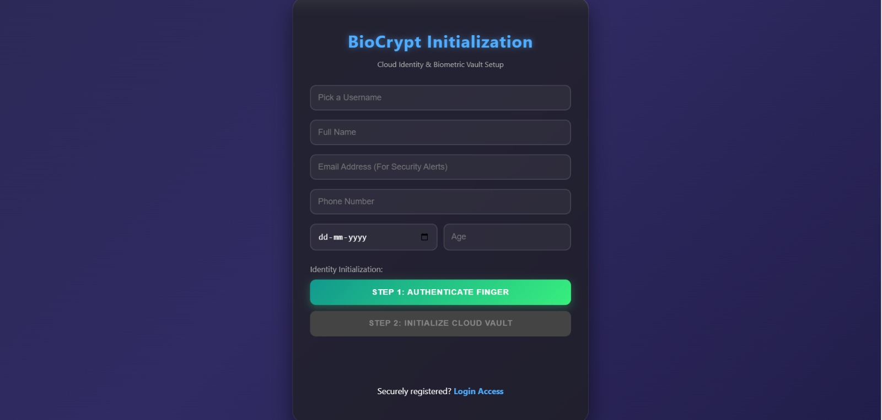
Results

Slide 25
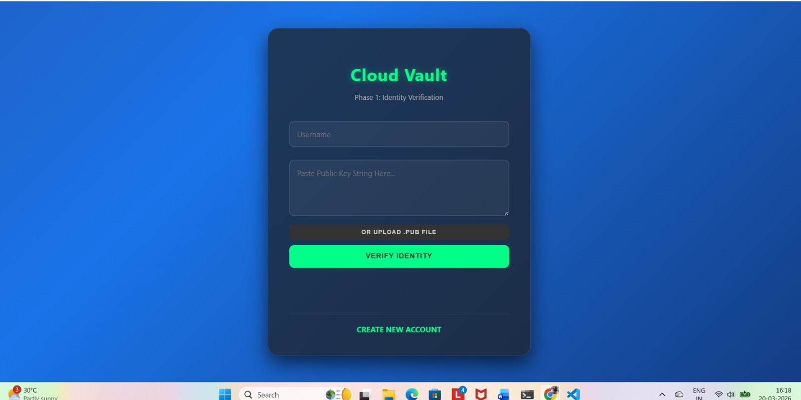
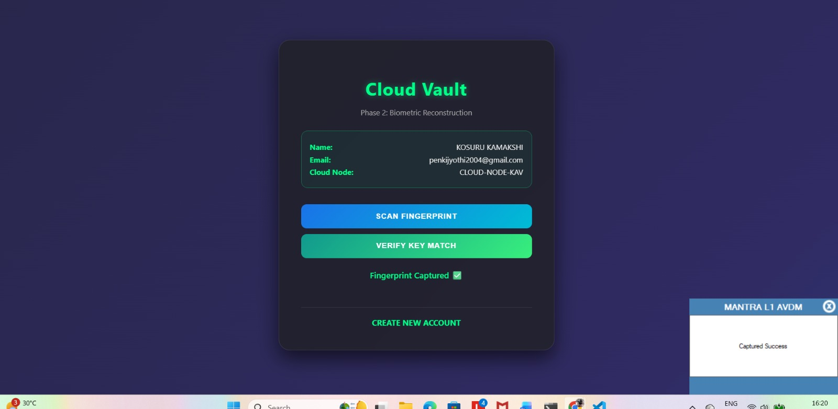

Slide 26
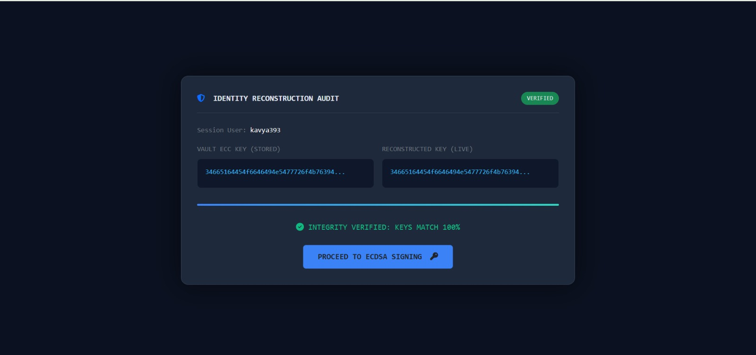
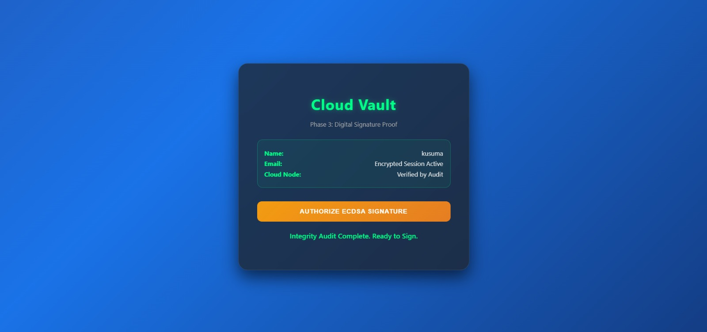

Slide 27
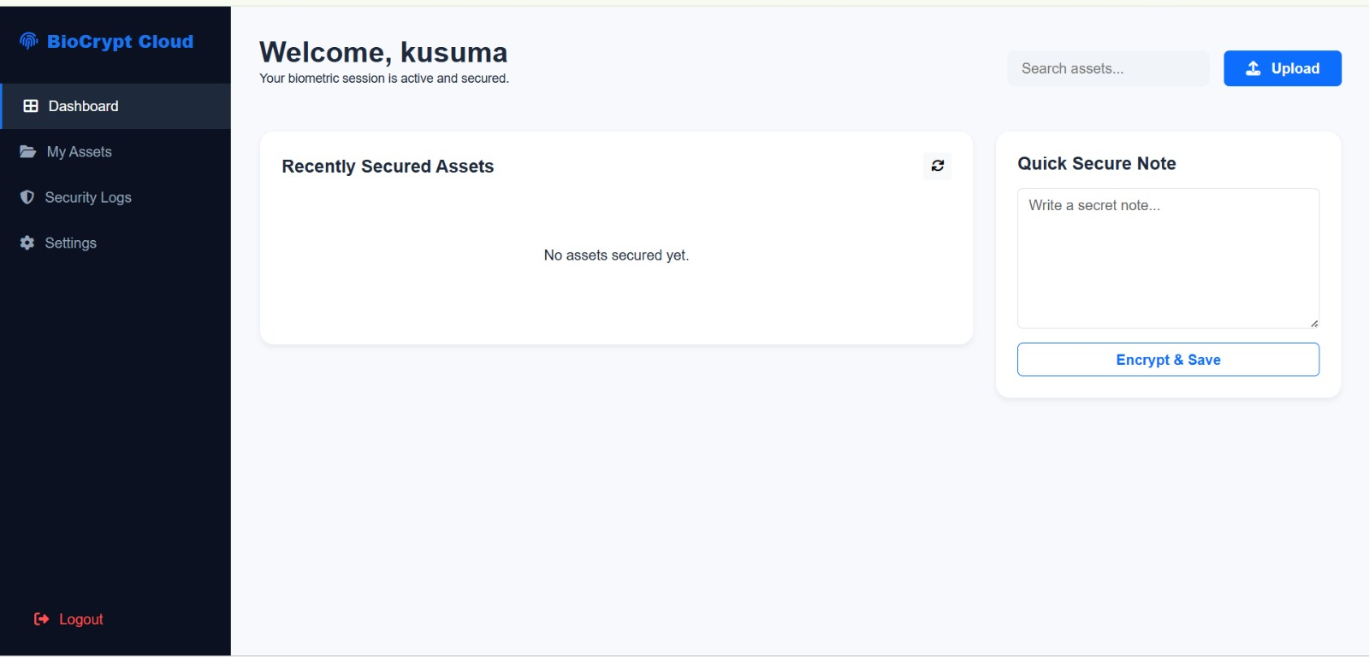
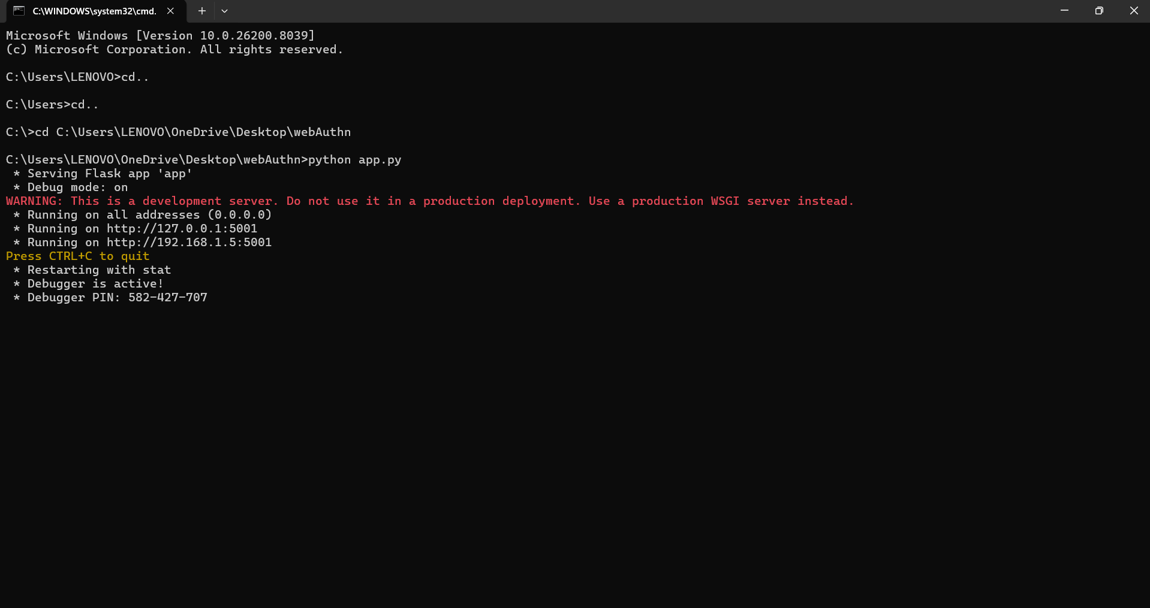

Slide 28
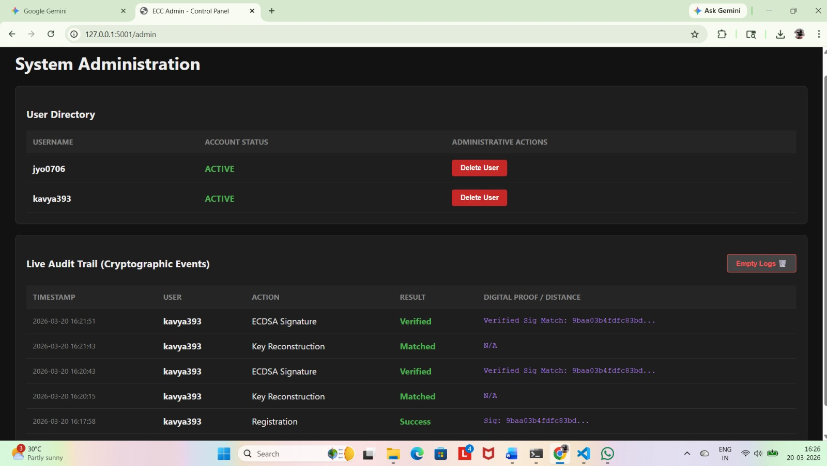

Slide 29
CONCLUSION
The successful implementation of this project demonstrates that biometric-derived keys, combined with Elliptic Curve Cryptography (ECC), provide a superior alternative to traditional password-based authentication. By utilizing SHA-256 hashing and Fuzzy Extractors, the system creates a stable and unique cryptographic identity directly from a user’s physical traits. This "Zero-Knowledge" approach ensures that sensitive biometric data never leaves the client device, effectively eliminating the risk of large-scale credential theft from cloud databases.
The use of biometric data ensures strong user identity verification, while ECC provides lightweight and high-level security suitable for modern cloud and IoT applications. The proposed system improves security, reduces computational overhead, and enhances user convenience by avoiding the need to remember complex passwords.
Overall, this project demonstrates that integrating biometrics with ECC is an effective approach for achieving secure, scalable, and user-friendly authentication in cloud systems. Future improvements can include multi-factor authentication enhancements and advanced biometric techniques for even higher security.

Slide 30
REFERENCES
S. Li, K.-K. R. Choo, Q. Sun, W. J. Buchanan, and J. Cao, “Iot forensics: Amazon echo as a use case,” IEEE Internet Things J., vol. 6, no. 4, pp. 6487–6497, 2019. https://doi.org/10.1109/JIOT.2019.2906946
J. Gubbi, R. Buyya, S. Marusic, and M. Palani swami, “Internet of things (iot): A vision, architectural elements, and future directions,” Future Gener. Compute. Syst., vol. 29, no. 7, pp. 1645–1660, 2013. https://doi.org/10.1016/j.future.2013.01.010
A. Botta, W. De Donato, V. Persico, and A. Pesca's, “Integration of cloud computing and internet of things: a survey,” Future Gener. Compute. Syst., vol. 56, pp. 684–700, 2016. https://doi.org/10.1016/j.future.2015.09.021
N. Alhakbani, M. M. Hassan, M. A. Hossain, and M. Alnuem, “A framework of adaptive interaction support in cloud-based internet of things (iot) environment,” in Proc. IDCS, vol. 8729, 2014, pp. 136–146. https://doi.org/10.1007/978-3-319-11692-1_12

Slide 31
5. M. S. Hossain and G. Muhammad, “Cloud-assisted industrial internet of things (iiot)–enabled framework for health monitoring,” Compute. Networks., vol. 101, pp. 192–202, 2016. https://doi.org/10.1016/j.comnet.2016.02.023
R. Amin, N. Kumar, G. Biswas, R. Iqbal, and V. Chang, “A light weight authentication protocol for iot-enabled devices in distributed cloud computing environment,” Future Gener. Compute. Syst., vol. 78, pp. 1005–1019, 2018. https://doi.org/10.1016/j.future.2016.11.002
Q. Jiang, N. Zhang, J. Ni, J. Ma, X. Ma, and K.-K. R. Choo, “Unified biometric privacy preserving three-factor authentication and key agreement for cloud-assisted autonomous vehicles,” IEEE Trans. Veh. Technol., vol. 69, no. 9, pp. 9390–9401, 2020. https://doi.org/10.1109/TVT.2020.3009927
J. Song, Q. Zhong, W. Wang, C. Su, Z. Tan, and Y. Liu, “Fpdp: Flexible privacy preserving data publishing scheme for smart agriculture,” IEEE Sensors J., vol. 21, no. 16, pp. 17430–17438, 2021. https://doi.org/10.1109/JSEN.2021.3070547

Slide 32


